Slide 1
Advanced materials processing with intelligent systems
Light materials interaction
Sergey Shevchik & Patrik Hoffmann

Slide 2
Content
Light meets materials
  Reflection
  Transmission
  Scattering
  Absorption
Time scales of effects
  Fluorescence
  Heating

Slide 3
Light absorption
Light that is absorbed makes a photon disappear !
  Where is the energy going?
Time scales of effects
  Fluorescence
  Heating

Slide 4
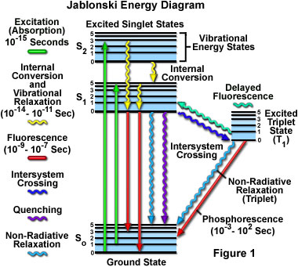
Absorption & Fluorescence
Absorption & fluorescence in a single molecule, ion, atom
!
non-radiative transition → transformation into heat
http://micro.magnet.fsu.edu/primer/techniques/fluorescence/fluorescenceintro.html

Slide 5
Contents
Absorbed light → Heat
Heat flow (heat equation)
Notes:
Thermal – black body emission – Planks law

Slide 6
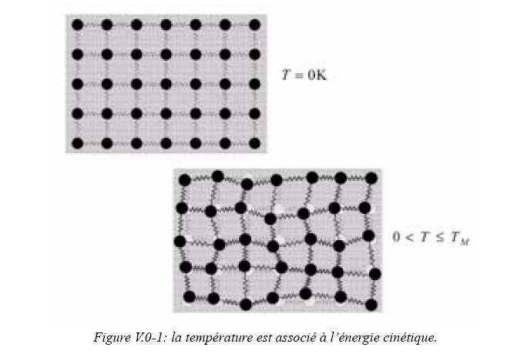
Heat
Heat flows from warm to cold, Fourier law
Heat = energy contained in excited phonons (lattice vibrations)
for liquids: additionally in rotation of molecules

Slide 7
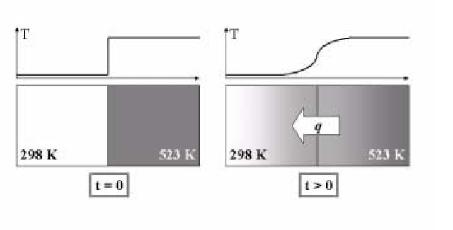
Heat flux
Which parameters determine the final state (temperature distribution) ?
Which parameters influence the dynamics of the flow?
thermal capacity, density/mass
thermal capacity, thermal conductivity, density
Notes:
HEAT FLOW
finger toching the oven – burned finger

Slide 8
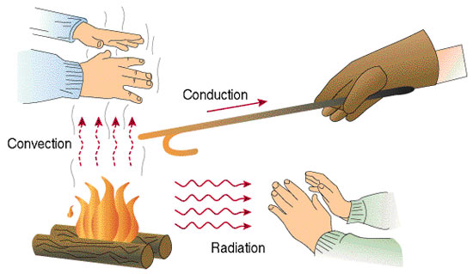
How heat can be transported?
Other (indirect) means?

Slide 9
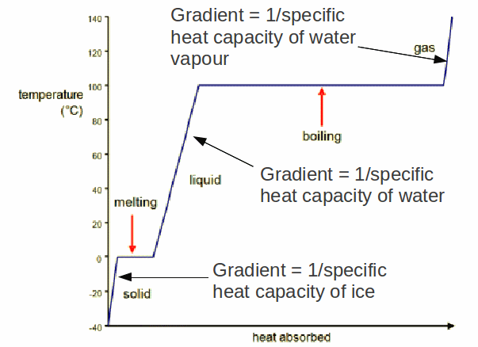
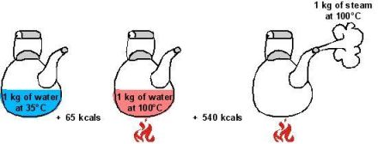
Phase Transition
evaporation needs much more (5x-10x) energy than melting and heating the material !!!

Slide 10
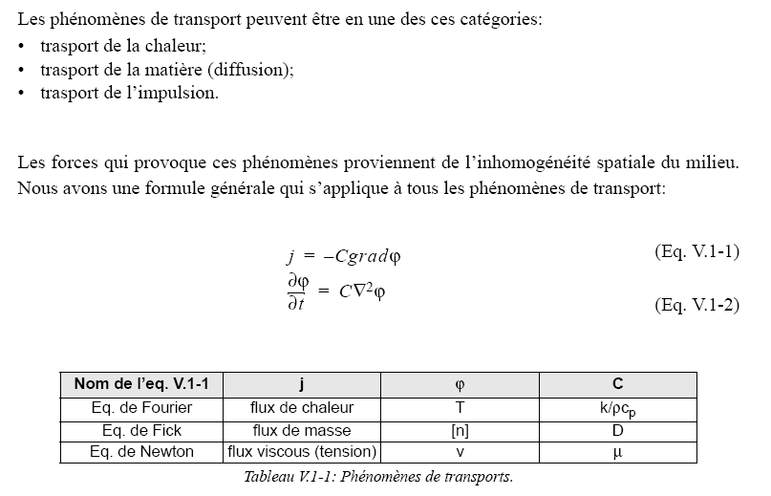
Transport Phenomena
Heat flow
Materials flow (diffusion)
Viscosity
Driving force for transport are spatial inhomogeneities, i.e. gradients
Transported quantity
System state
Material property
Heat flow
Mass flow
Momentum flow

Slide 11
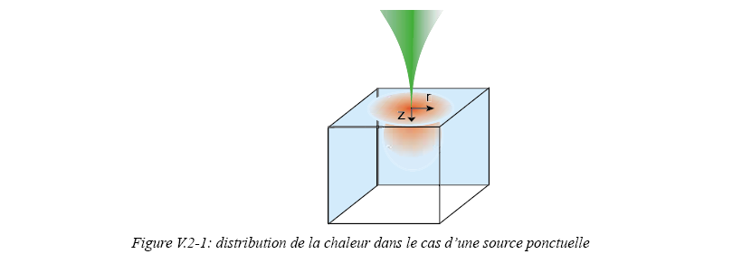
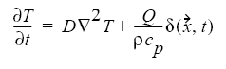
Heat flow
form of the equation in case the external heat source is present
how temperature field changes in time
based on existing temperature distribution
and external heat sources and heat losses

Slide 12
Heat Source – Laser Irradiation
Heat flux
  Laser heating depends on a large number of parameters
    Optical properties of material (R, α, ..)
    Heat transport in and out of irradiation zone
    Heat storage in and out of zone
    Phase transition Enthalpies
    Chemical reaction Enthalpies
    …

Slide 13
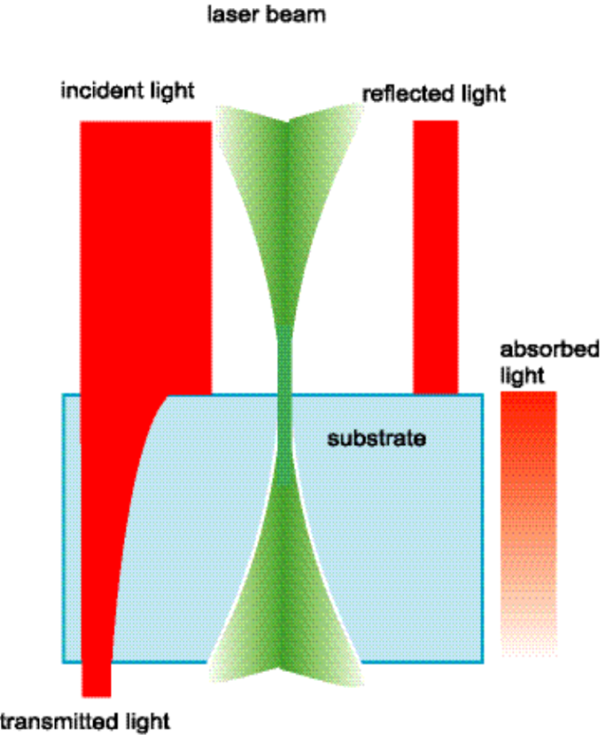
Laser (light) Source Term
the (maximum) laser light intensity not reflected
from surface (z=0).
the intensity distribution of the laser light
in the xy-plane.
heat distribution in depth
in simplified case α(T)=const

Slide 14
Anurag Singhania Master thesis 2020
Computational result: approach 1
Wafer at ambient temperature Preheated wafer
0.1 ms

Slide 15
Anurag Singhania Master thesis 2020
Experimental results
10 W, substrate preheated to 820 C, varying pulse durations
5 ms 2 ms 1ms 0.75 ms 0.5 ms 0.25 ms

Slide 16
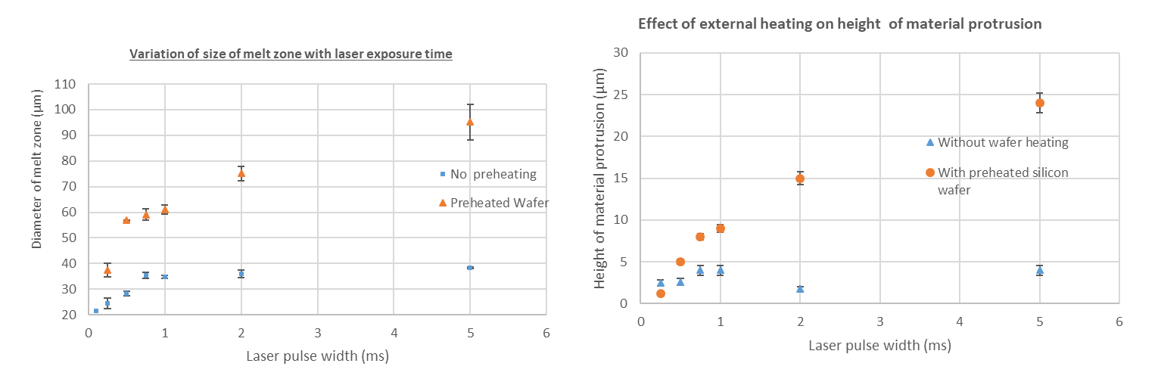
Anurag Singhania Master thesis 2020
Experimental results
Effect of preheating wafer
Diameter of the melt zone increases roughly 2 to 3 times irrespective of the pulse duration
Height of material expulsion in the center increases significantly with increase in the pulse duration

Slide 17

Heat Losses and Other Terms
Conduction
Convection
Radiation
Phase transitions
Chemical reactions

Slide 18
Free Convection
For surface A > 1cm²
air
liquid
cooling by gas convention is not very efficient

Slide 19
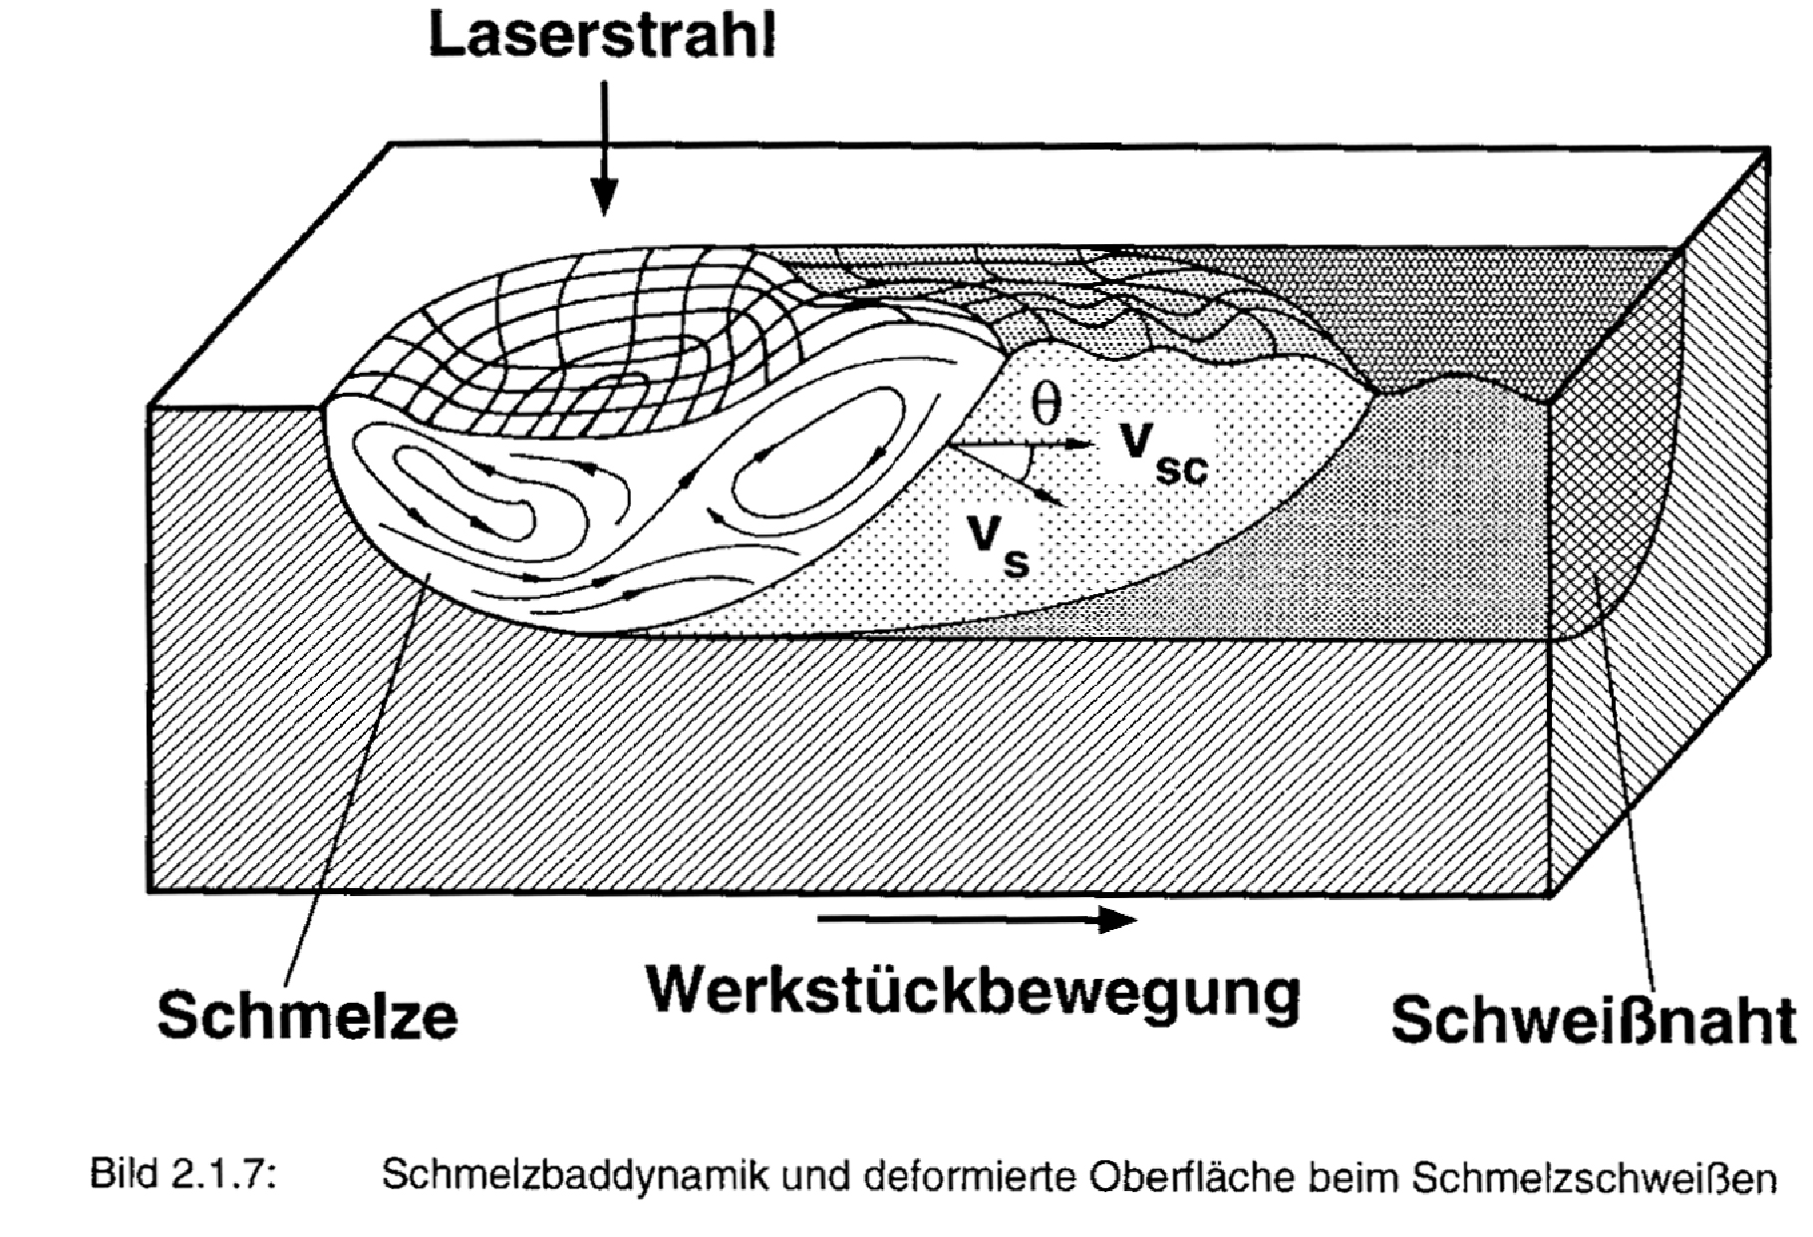
Laser Welding
Liquid convection still plays an important role in “slow” processes.
e.g. welding (drilling, cutting)
laser beam
melt
Sample movement
welded seam

Slide 20
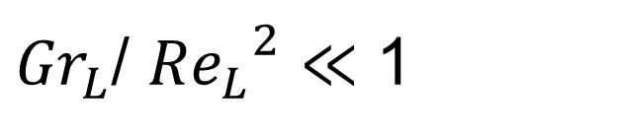
Forced Convection
Free convection is negligible if:
${Gr}_{L}$/ ${{Re}_{L}}^{2}$ $≪$ 1
Ratio of buoyancy to viscous forces
Ratio of inertia and viscous forces
g = gravitational acceleration m/s²
β = volumetric expansion coefficient K⁻¹
ν = kinematic viscosity m²/s
F.P. Incropera, D.P. DeWitt; Fundamentals of Heat and Mass Transfer; John Wiley & Sons, NY, 4th ed. 1996

Slide 21
Radiation Cooling
Stefan–Boltzmann law
increases very strongly with temperature!!!
maybe important in some cases.

Slide 22
Phase changes & Chemical reactions
ΔH_{m}= 2-10 kcal/mol
ΔH_{v}= 50-100 kcal/mol

Slide 23
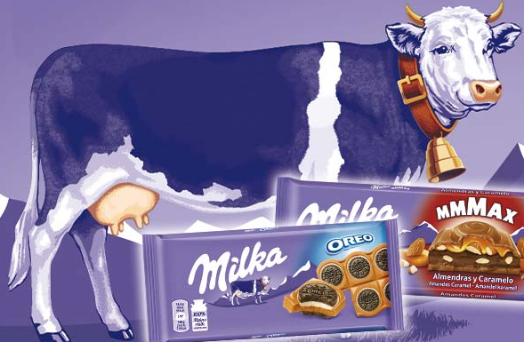
Comparison: Convection - Radiation
Example:
emissivity 0.4

Slide 24
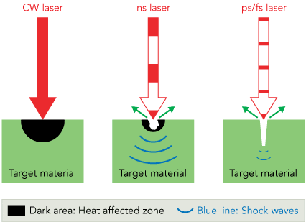
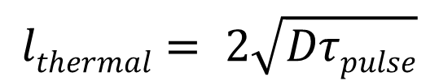

Thermal Penetration Depth
Pulsed laser irradiation results in a temperature rise in the material to a limited depth.
Thermal penetration depth
$$lthermal= 2\sqrt{Dτpulse}$$
D = $\frac{κ}{ρ Cp}$
Heat diffusivity
κ – heat conductivity
ρ – material density
C_{p} – heat capacity

Slide 25
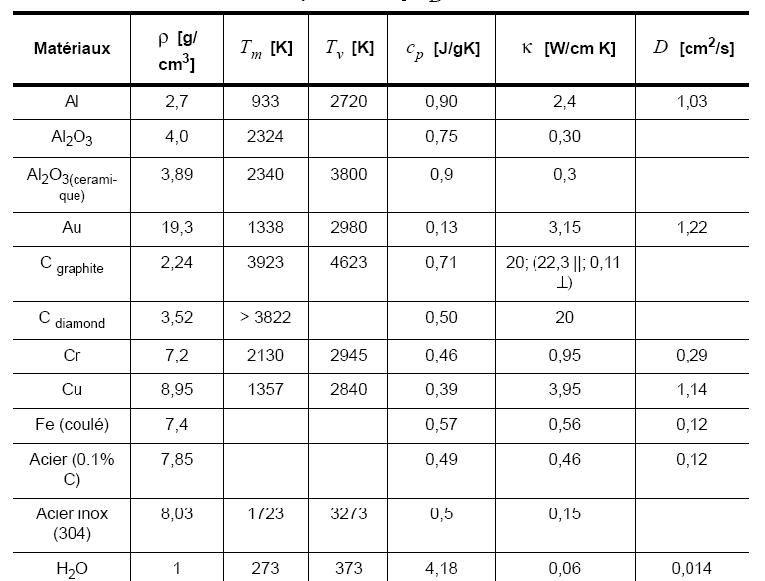
Table of material properties
good metal
0.086
ceramics
good metal
“bad” metal
“bad” metal
water & polymer

Slide 26
Cooling/heating terms
Convection may play a role for cooling of the whole machined piece of material – not relevant for machining
Radiation may have contribution at very high temperatures
In most cases cooling of the laser machined region takes place by heat conduction in the piece

Slide 27
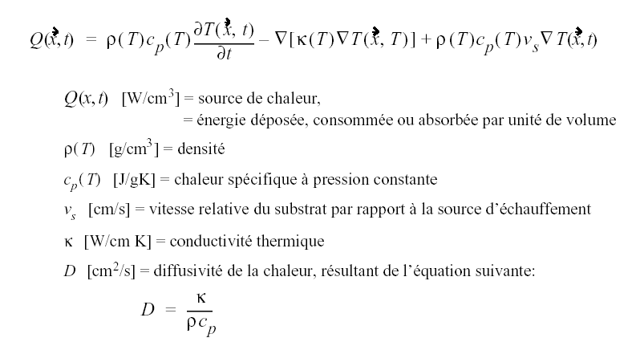
Heat equation moving substrate
heating of the
material
heat brought
by moving
heat conducted
away
Heat source
Energy deposited, consumed or absorbed by unit of volume
Mass density
Specific heat at constant pressure
Relative speed of sample to beam
Thermal conductivity
Heat diffusivity

Slide 28
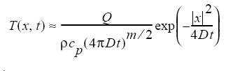
Heat flow in 3 dimension
Solution:
m = dimension of problem (m = 1, 2, 3)
Q = total energy deposited
ρ = mass density per distance, surface or volume (g/cm^{m})

Slide 29
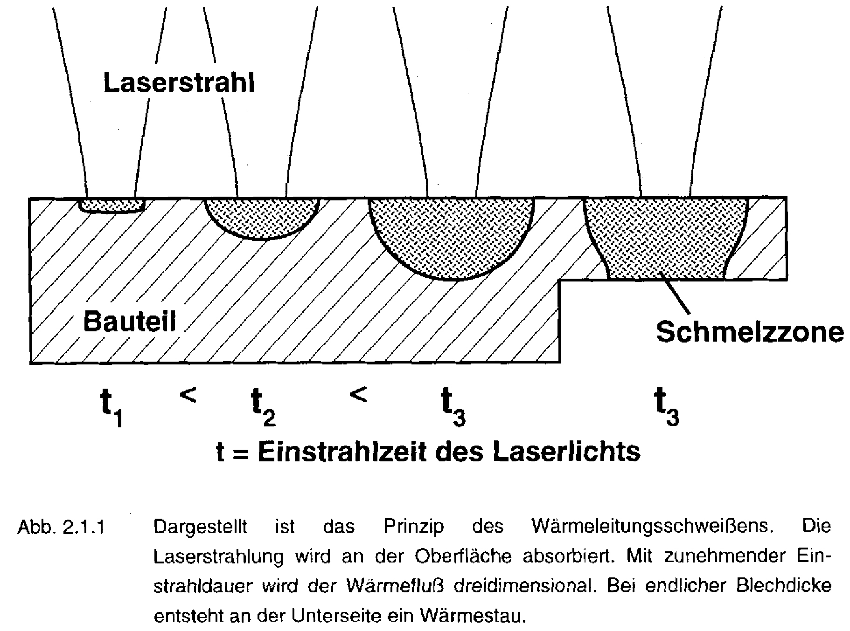
Laser Welding
What is the dimensionality of the heat flow problem at each of the stages?
Laser beam
sample
Melt zone

Slide 30
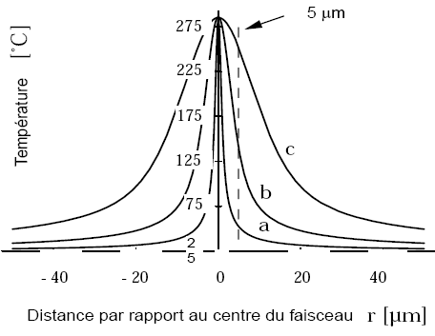
Result of linearized heat equation
Semi-infinite substrate
Si, λ = 514 nm
  All optimized to get
  T_{max} in center of 287°C
Distance from spot center r (μm)
case | Waist w₀ (μm) | Power (mW)
a | 1 | 173.5
b | 5 | 574
C | 15 | 1535

Slide 31
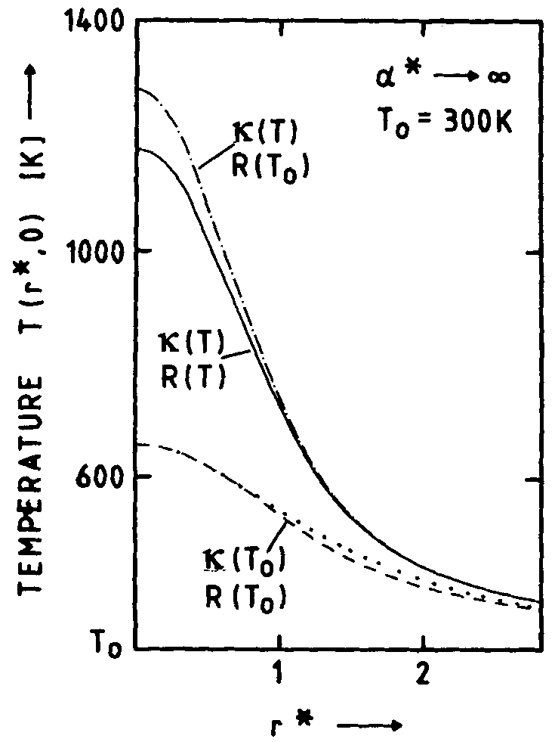
Result of numerical heat flow simulations
Semi-infinite substrate
Si, λ = 514 nm
temperature dependence of heat conductivity and reflectivity is important to consider!!!!

Slide 32
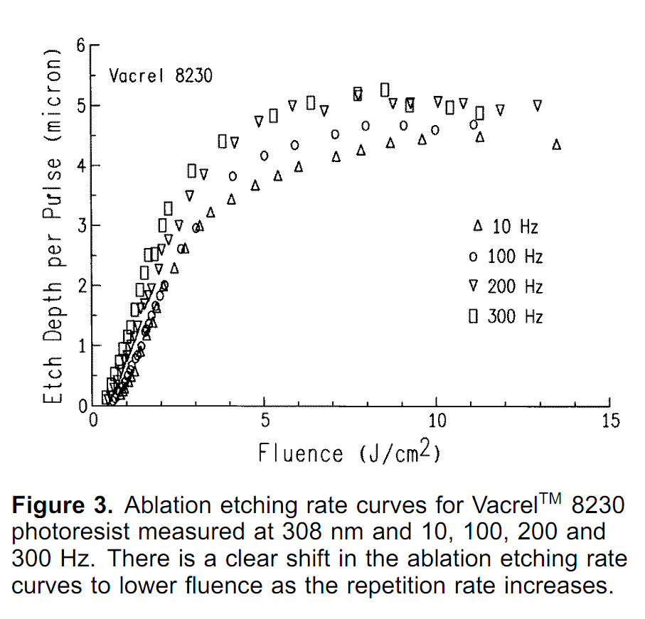
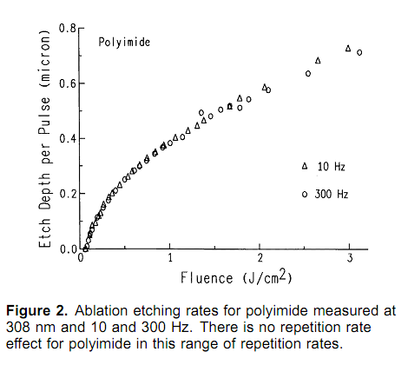
Heat Accumulation - Effect of the Repetition Rate
Photoresist Vacrel 8230
α~5000cm⁻¹@308nm – deep light penetration
effect visible at low rep.rate
Polyimide
α~10⁵cm⁻¹@308nm - absorption on the surface
Effect will be visible only at high rep.rate

Slide 33
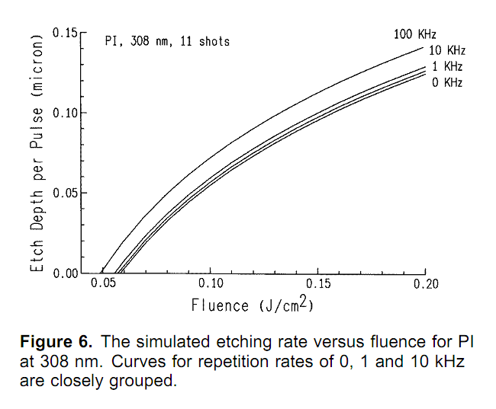
Heat Accumulation
Polyimide
α~10⁵cm⁻¹@308nm - absorption on the surface
Effect will be visible only at high rep.rate
high repetition rate ν results in heat accumulation effect and increase in ablation rate
Burns F.C. and Cain S.R.; J. Phys. D. Appl. Phys., 29 (1996) 1349

Slide 34
Complete heat transfert through wall/window
T₁
T₂
window
wall

Slide 36
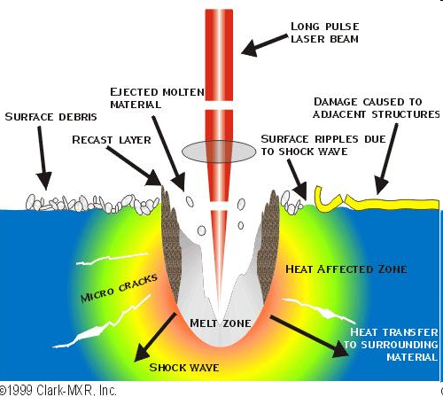
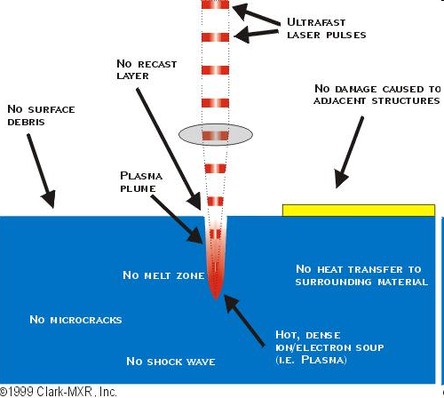
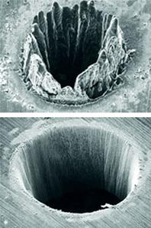
ns-machining vs. fs-machining
ns
fs

Slide 37
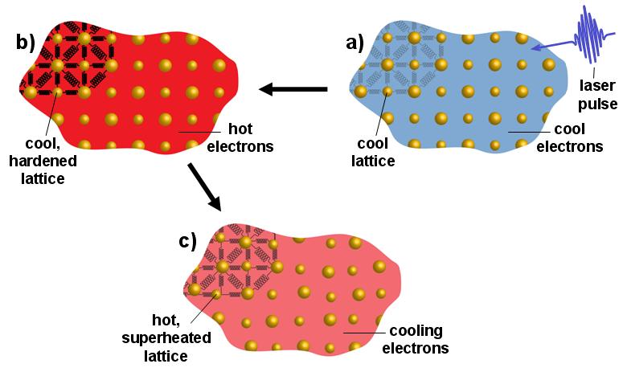
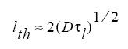
Ultrafast Laser Pulses
for τ<1-10 ps pulses - light absorption is faster than heat transfer from electron to atoms
cool lattice
heating rate is very high – heat penetration is low

Slide 38
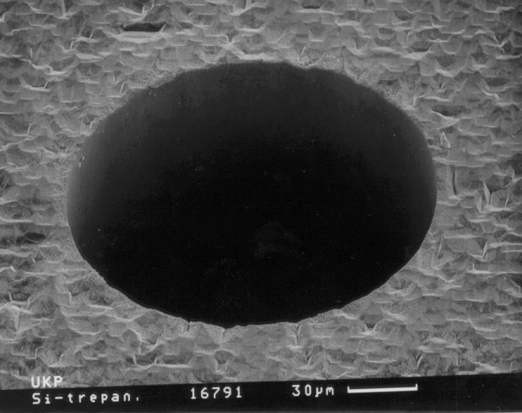
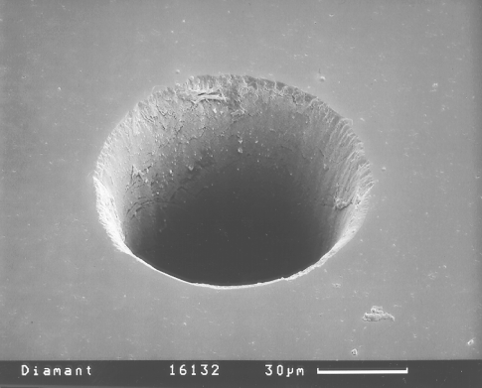
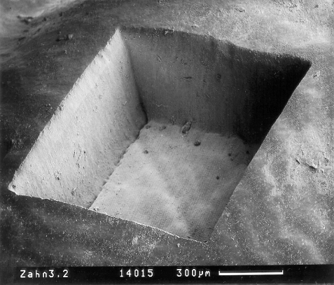
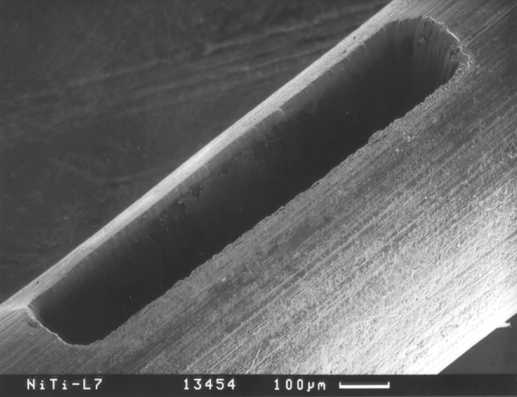
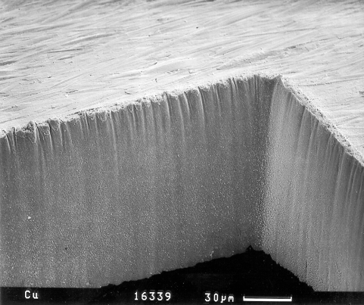
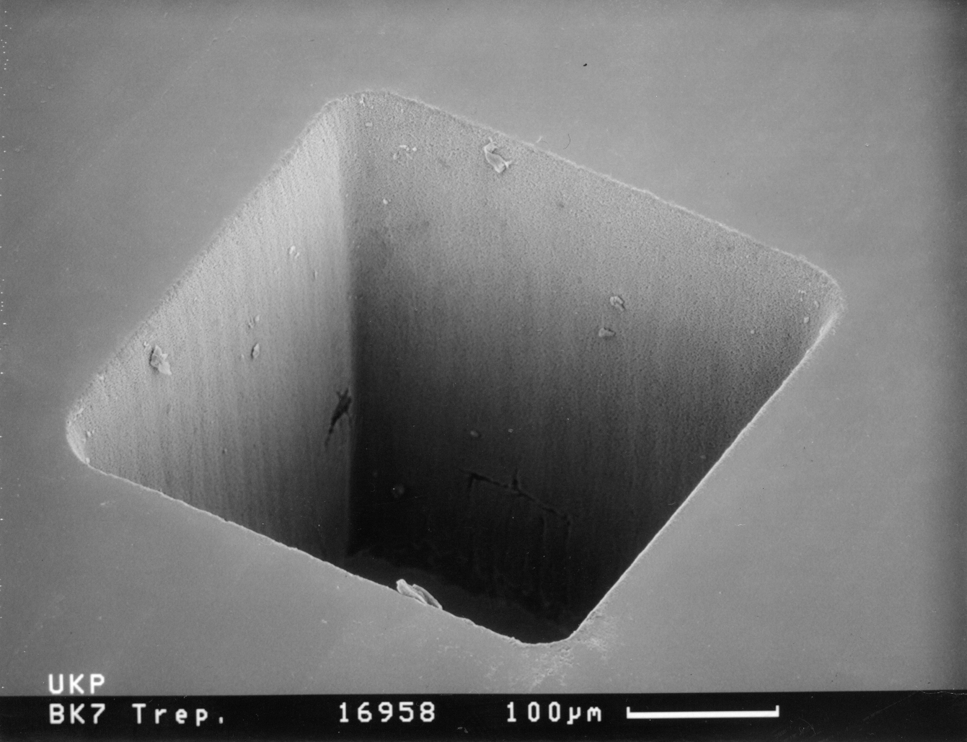
fs-laser machining
Silizium
Diamant
Glas
Zahnschmelz
Speziallegierungen
Kupfer

